Slide 1
Configuring DNS and DHCP

Slide 2
Understanding DNS
Domain Name System (DNS) is the system that associates hostnames with IP addresses.
The DNS Hierarchy
In a name like www.example.com, three parts are involved
1. top-level domain (TLD) .com
the top-level domains that have been established by the Internet Assigned Numbers Authority (IANA).
common top-level domains are .org, .gov, .edu, .mil
top-level domains that exist for countries, such as .uk, .ca, .in, .cn, and .nl.

Slide 3
2. Each of the top-level domains has a number of name servers.
The servers that have information on the hosts within the domain
such as redhat.com, example.com
3. The root domain is at the top of the DNS hierarchy
It is used to connect all of the top-level domains together

Slide 4
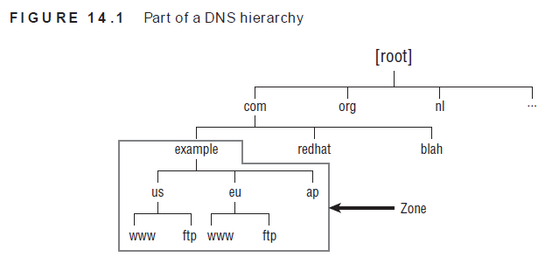
Within DNS, a name server can be configured to administer just the servers within its domain.
The entire portion of DNS for which a name server is responsible is referred to as a zone.

Slide 5
It is also possible to split subzones. This is referred to as the delegation of subzone authority. This means a sub domain has its own name server, which has resource records for the sub domain

Slide 6
DNS Server Types
Every zone has at least a primary name server, also referred to as the master name server.
This is the server that is responsible for a zone and the one on which modifications can be made
To increase redundancy in case the master name server goes down, zones are also often configured with a secondary or slave name server.

Slide 7
To keep the primary and secondary name servers synchronized, a process known as zone
transfer is used.
In a zone transfer, a primary server can push its database to the secondary name server, or the secondary name server can request updates from the primary name server
In DNS traffic, both primary and secondary name servers are considered to be authoritative name servers

Slide 8
The DNS Lookup Process
To get information from a DNS server, a client computer is configured with a DNS resolver.
the DNS resolver is in the configuration file /etc/resolv.conf.
In the DNS resolver, more than one name server is often configured to handle cases where the first DNS server in the list is not available

Slide 9
assume that a client is in the example.com domain and wants to get the resource record for www.sander.fr
name server will check its cache
If the name server cannot answer the request from cache, it will first check whether a forwarder has been configured
If no forwarder has been configured, the DNS server will resolve the name step-by-step.

Slide 10
DNS Zone Types
Most DNS servers are configured to service at least two zone types.
First there is the regular zone type that is used to find an IP address for a hostname
To find the name for a specific IP address.This type of request is handled by the in-addr.arpa zones.
The name of the in-addr
.arpa zone is the reversed network part of the IP address followed by in-addr.arpa. For example, if the IP address is 193.173.10.87, the in-addr.arpa zone would be 87.10.173.in-addr.arpa

Slide 11
Setting Up a DNS Server
The Berkeley Internet Name Domain (BIND) service is used to offer DNS services on Red Hat Enterprise Linux.
If you run a BIND service on your server, it will do the recursion on behalf of all clients.
You just need to install the BIND service and make sure that it allows incoming traffic.
For cache-only name servers, it also makes sense to configure a forwarder.

Slide 12
Setting Up a Cache-Only Name Server
1.Open a terminal, log in as root, and run
yum -y install bind-chroot on the host computer to install the bind package.
2. With an editor, open the configuration file /etc/named.conf

Slide 13
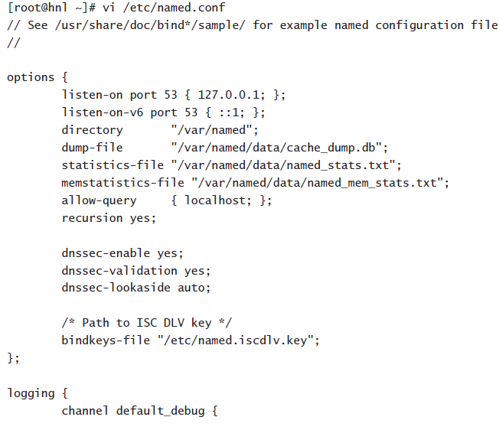

Slide 14
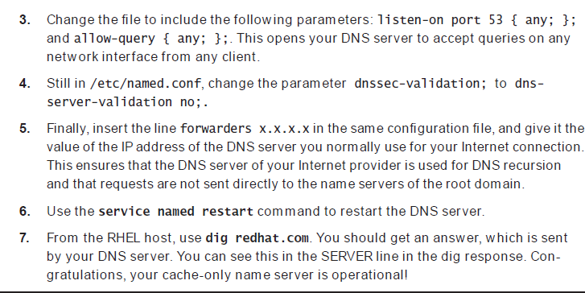

Slide 15
Setting Up a Primary Name Server
To set up a primary name server, we need to define a zone
First tell the DNS server which zones it has to service.
create a configuration file for the zone in question
To tell the DNS server which zones it has to service, you need to include a few lines in
/etc/named.conf

Slide 16
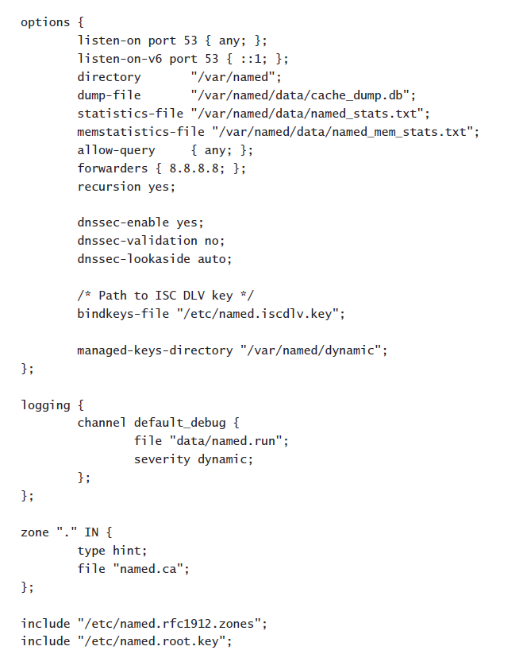
[root@rhev ~]# cat /etc/named.conf

Slide 17
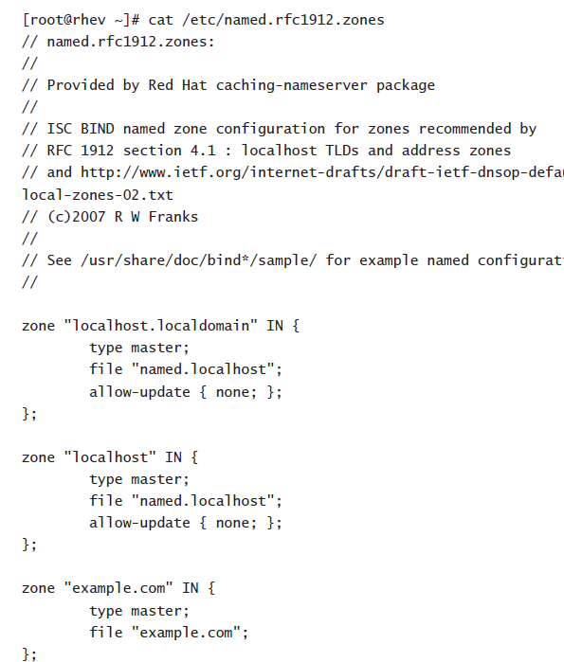

Slide 18
To tell the DNS server that it also has to service another zone, add the following few lines:
zone "example.com" IN {
type master;
file "example.com";
};
The first line, zone "example.com" IN, tells named that it is responsible for a zone with the name example.com that is of the type IN. This means this zone is servicing IP addresses.

Slide 19
The first line tells named that this is the master server. The second line tells named
that the configuration file is example.com. This file can, of course, be found in the directory /var/named, which was set in /etc/named.conf as the default directory

Slide 20
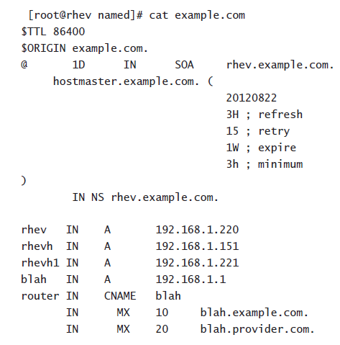

Slide 21
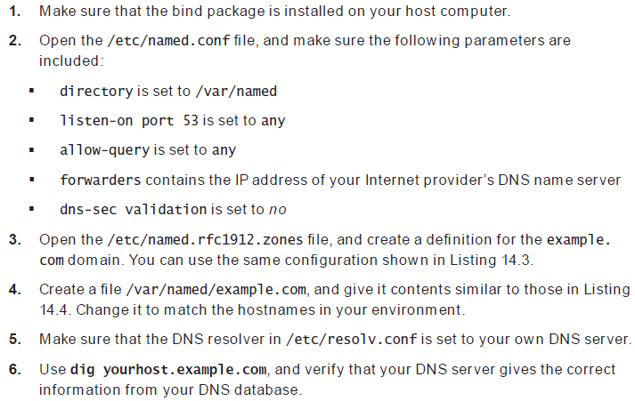
Setting Up a Primary DNS Server

Slide 22

Configuring an in-addr.arpa Zone
It allows external DNS servers to find the name that belongs to an incoming IP address.
Creating an in-addr.arpa zone works similarly to the creation of a regular zone in DNS.
We need to modify the /etc/named.rfc1912.zones file to define the in-addr.arpa zone

Slide 23
The network is 193.173.100.0/24, so the reverse network part is 100.173.193.in-addr.arpa.
1 PTR router.example.com

Slide 24
Setting Up a Secondary Name Server
A secondary server is one that synchronizes with the primary.
Thus, to enable this, you must first allow the primary to transfer data. You do this by setting the allow-transfer parameter for the zone as you previously defined it in the /etc/named.rfc1912.conf file.

Slide 25
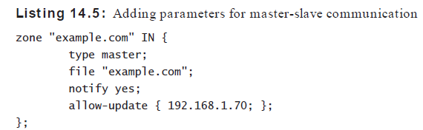
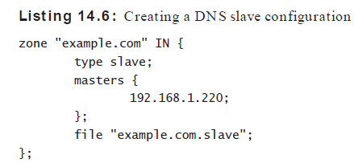
Once you have allowed updates on the primary server, you need to configure the slave.
This means that in the /etc/named.rfc1912.conf file on the Red Hat server, which you’re going to use as DNS slave, you also need to define the zone.

Slide 26
Understanding DHCP
The Dynamic Host Configuration Protocol (DHCP) is used to assign IP-related configuration to hosts in your network.
A DHCP server can be configured to assign more than 80 different parameters to its clients, of which the most commonly used are IP addresses, default gateways, and the IP address of the DNS name servers

Slide 27
When a client comes up, it will send a DHCP request on the network. This DHCP request is sent as a broadcast, and the DHCP server that receives the DHCP request will answer and assign an available IP address.
default lease time-This is the amount of time that the client can use an IP address it has received without contacting the DHCP server again

Slide 28
Setting Up a DHCP Server
To set up a DHCP server, after installing the dhcp package, you need to change common
DHCP settings in the main configuration f le: /etc/dhcp/dhcpd.conf

Slide 29
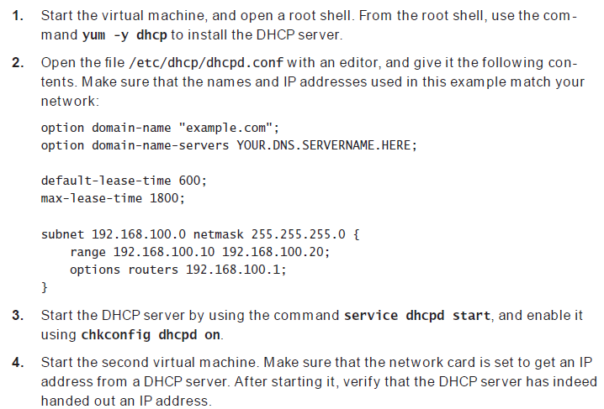
Setting Up a DHCP Server

Slide 30
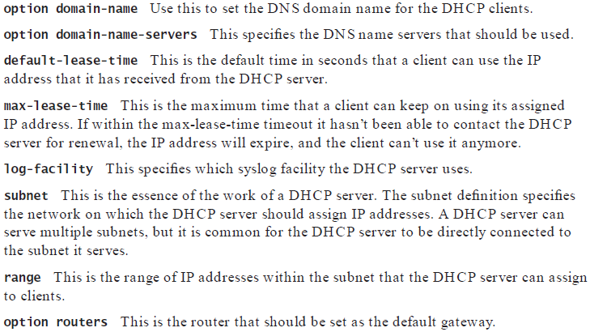

Slide 31
https://www.youtube.com/watch?v=yDAHSM2Pijc

